Slide 1
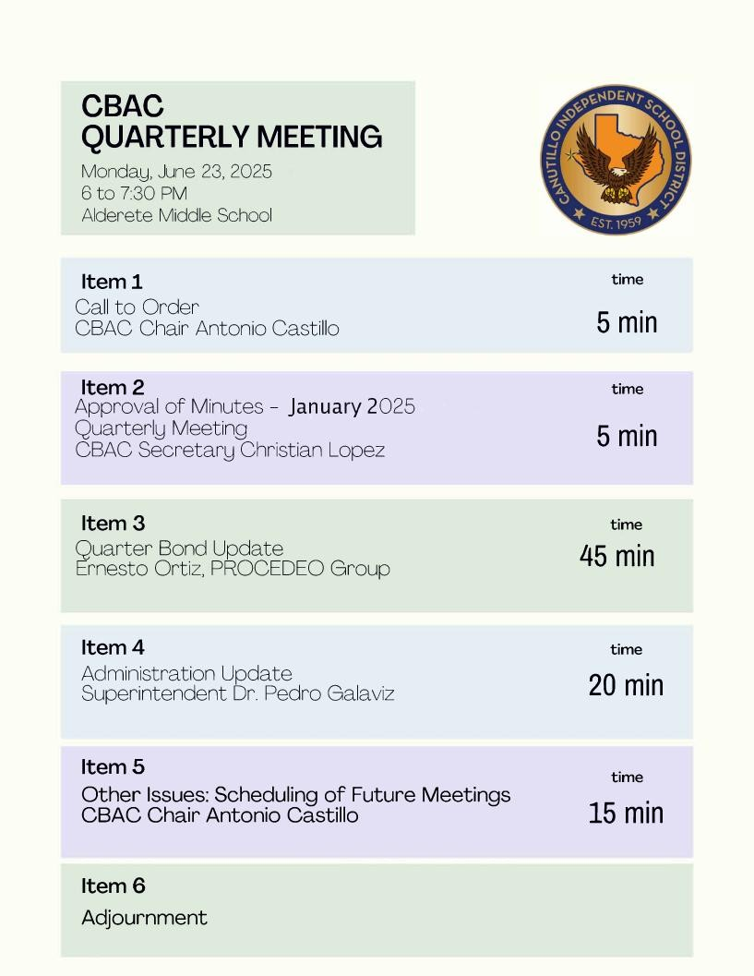
Slide for Meeting Agenda

Slide 2

Citizens Bond Advisory
Committee Meeting (CBAC)
CANUTILLO ISD CBAC MEETING | June 23, 2025

Slide 3


CANUTILLO INDEPENDENT SCHOOL DISTRICT
2024 Bond Program
Voters in the Canutillo Independent School District passed the historic Canutillo Bond 2024 on May 4, 2024. Canutillo Bond 2024 is the largest per-capita bond ever approved in El Paso County and is a catalyst program in helping Canutillo modernize existing campuses, address continued growth within the District’s boundaries and upgrade the District’s safety and security infrastructure.
Note- The 2024 Bond Website will be updated based on the information provided and approved by CISD in this report.
The 2024 Monthly Budget Report and Program Schedule are uploaded to the 2024 CISD Bond Website.

Slide 4
2024 CISD Bond Program – CBAC Officers
Antonio Castillo - Chair
Christian Lopez – Secretary

Slide 5
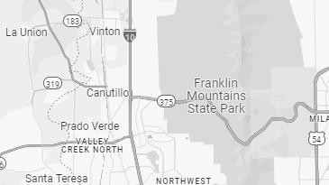


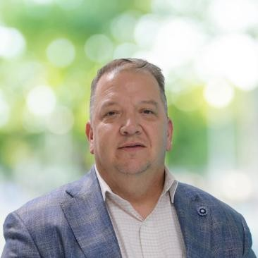


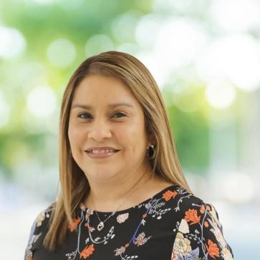
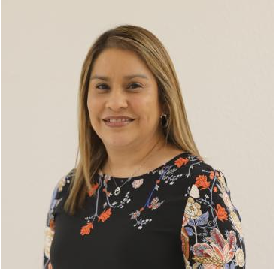
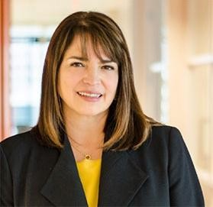

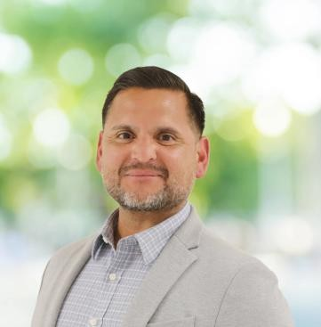

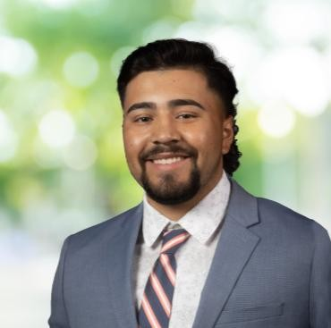
PROCEDEO TEAM MEMBERS TO DATE
Ernesto Ortiz
Program Director
David Martinez Jr.
Controls Manager
Raquel Bitar
Program Coordinator
Corina Heredia
Procurement Manager
Pamela Soto
Communications Manager
Karla Holguin
Owners Assistant Representative
Irene Nigaglioni, FAIA
Senior Design Manager, IN2
Peter Aguilar
Design Manager, IN2
Anthony Mariscal
Construction Manager
Alec Kleinhans
Project Manager
Gabriel Damian
Controls Assistant

Slide 6





2024 Bond Program Status – Program Status Update
Since our last Quarterly Update…
Board Meetings
04/27 Commissioning RFQ’s
05/27 Third Party RFQ’s
06/17 Design Development
06/XX Land Purchase – Davenport ES
Coordination
Webex System District Upgrades
Wi-Fi Upgrades
Third Party RFQs
Interactive Flat Panels
Security Camera Installation
Principal FF&E Budget
Design/CMAR
Project Design Meetings
05/06-07 Furniture Fair
Land Survey Coordination
AE/CMAR Project Design Review
AE/CMAR Project Cost Discussions
Community Engagement
04/17 Virtual Community Meeting
04/21 Community Meeting
05/02 CAFÉ Golf Tournament
05/14 Davenport ES Spring Carnival
March 25, 2025
June 23, 2025

Slide 7
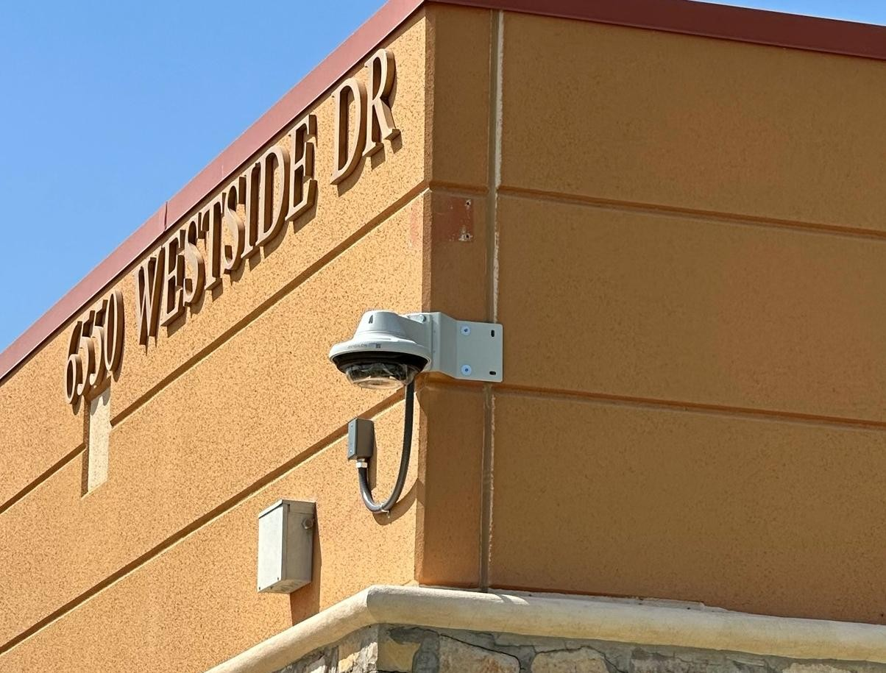
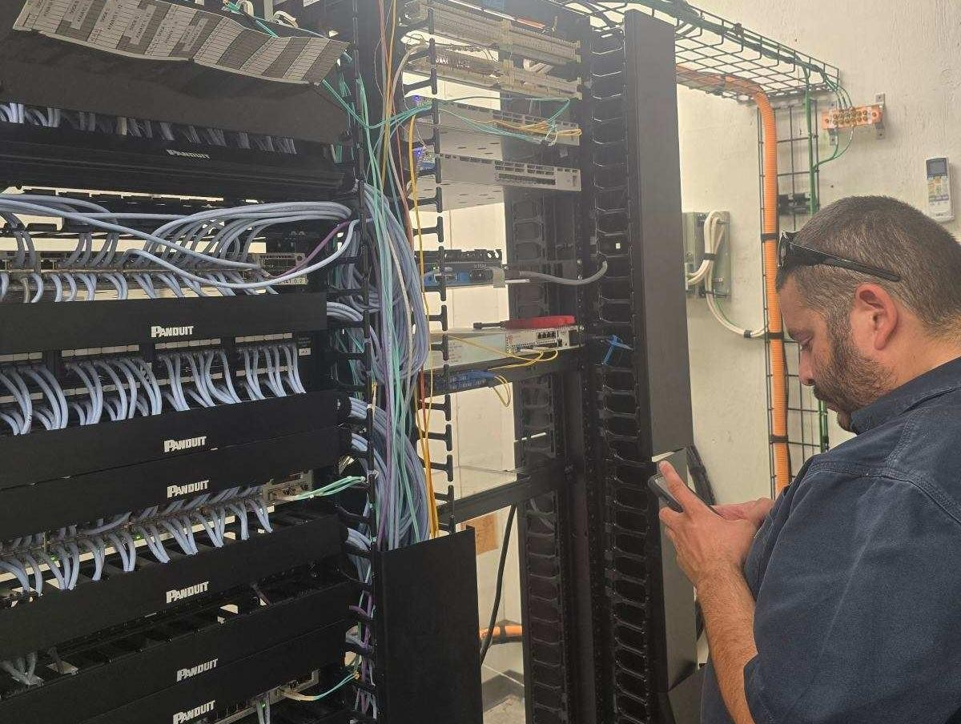
2024 Bond Program Status – Community Engagement
Damian ES Technology Upgrades
May 2025

Slide 8
2024 Bond Program Status – Community Engagement
Damian/Garcia ES Security Camera Upgrades
May 2025

Slide 9
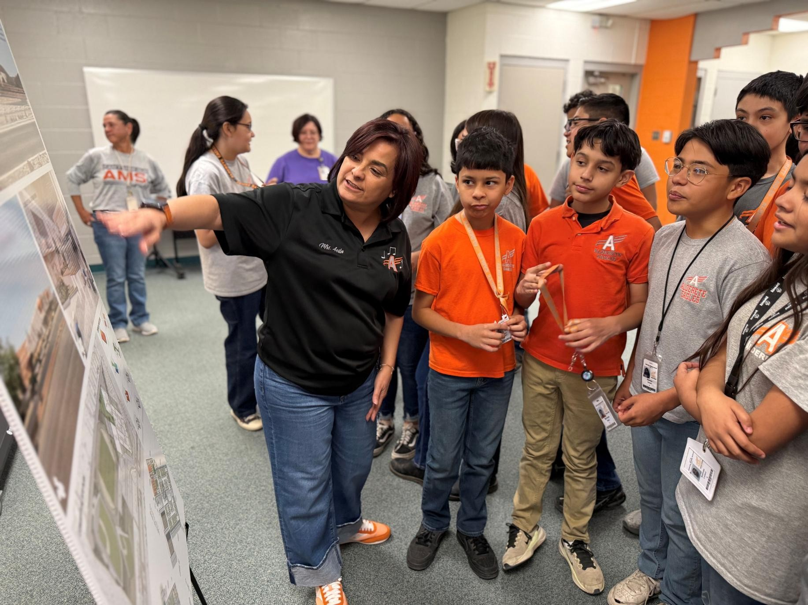
2024 Bond Program Status – Community Engagement
Alderete MS Bond Signage Unveiling
April 14, 2025

Slide 10
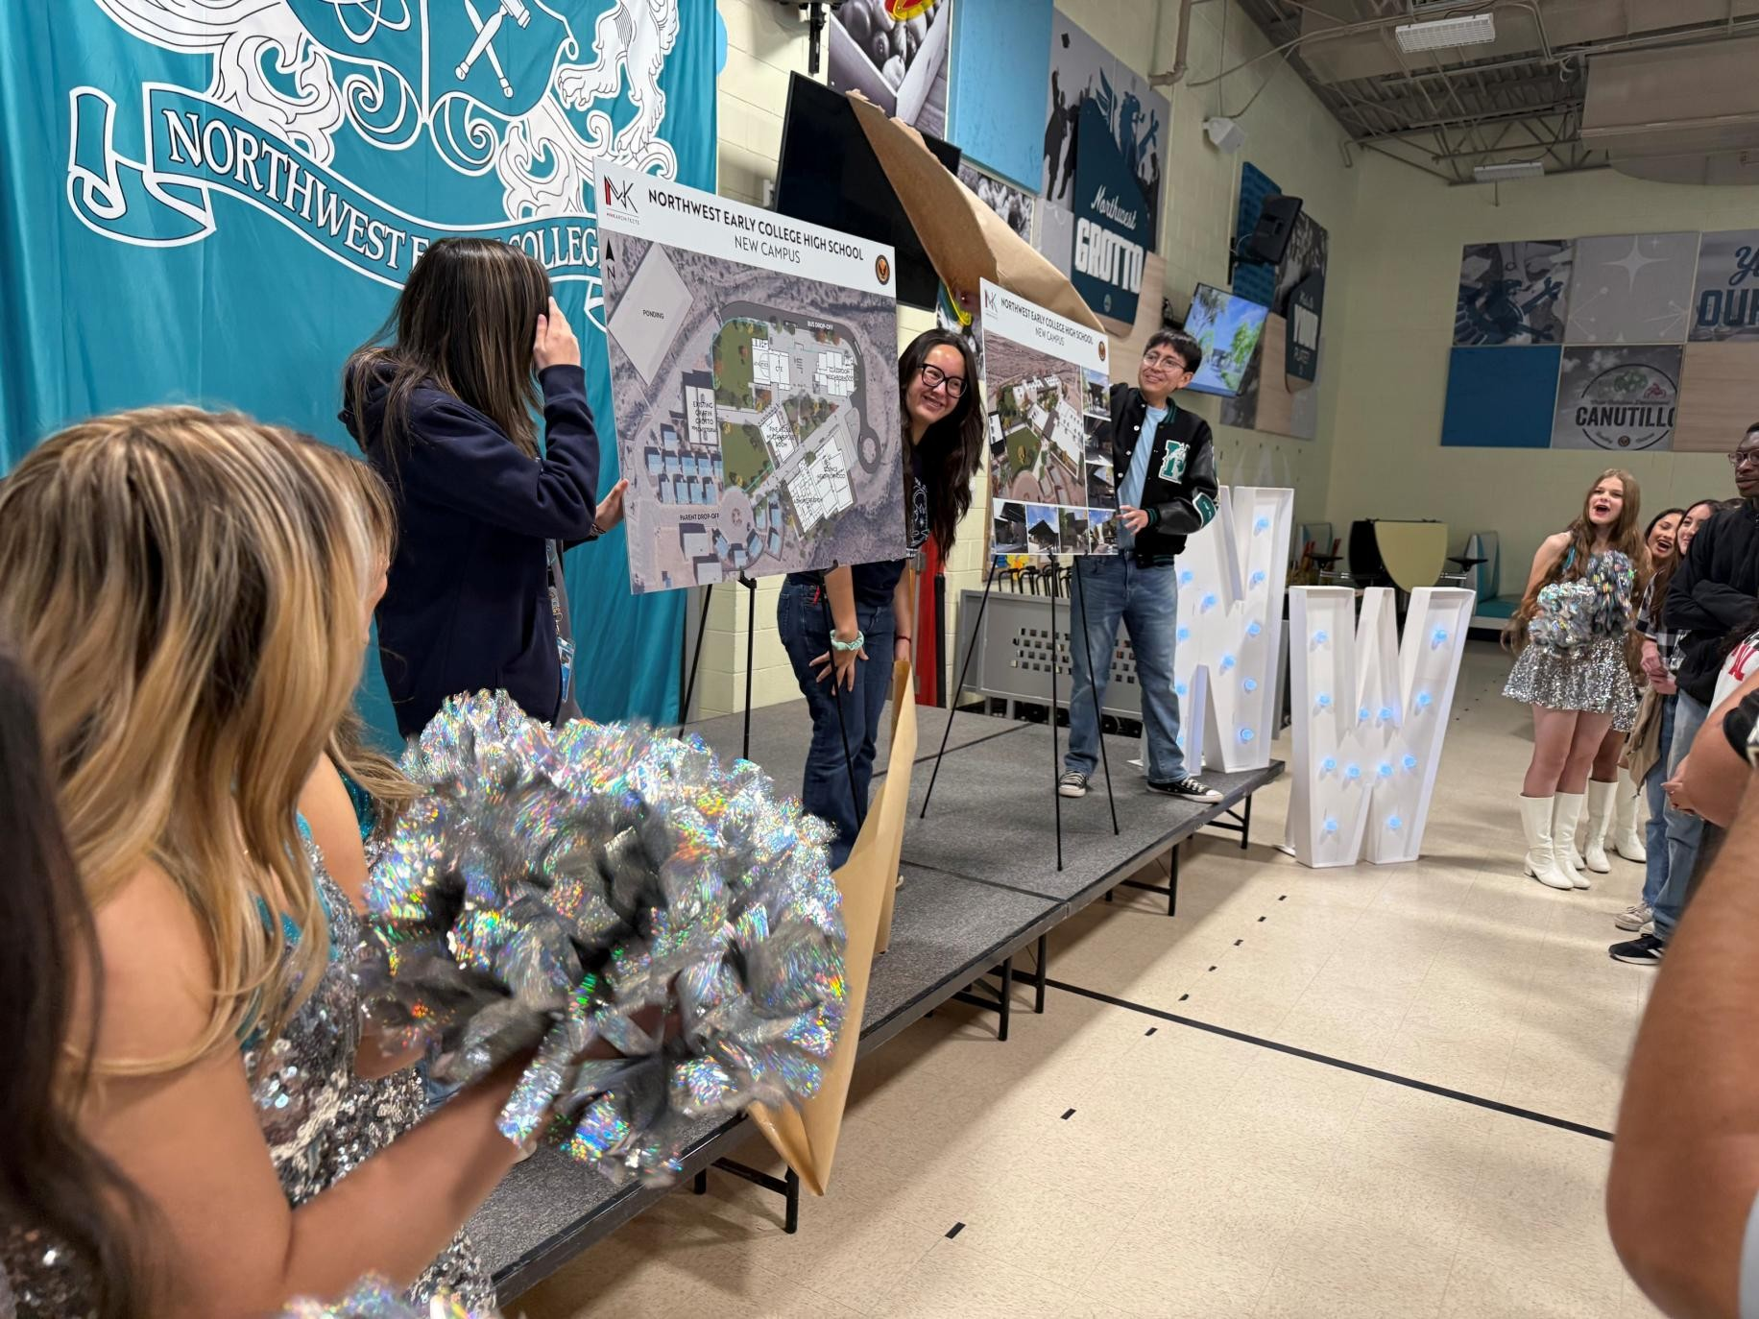
2024 Bond Program Status – Community Engagement
NW Early College Bond Signage Unveiling
April 14, 2025
2024

Slide 11
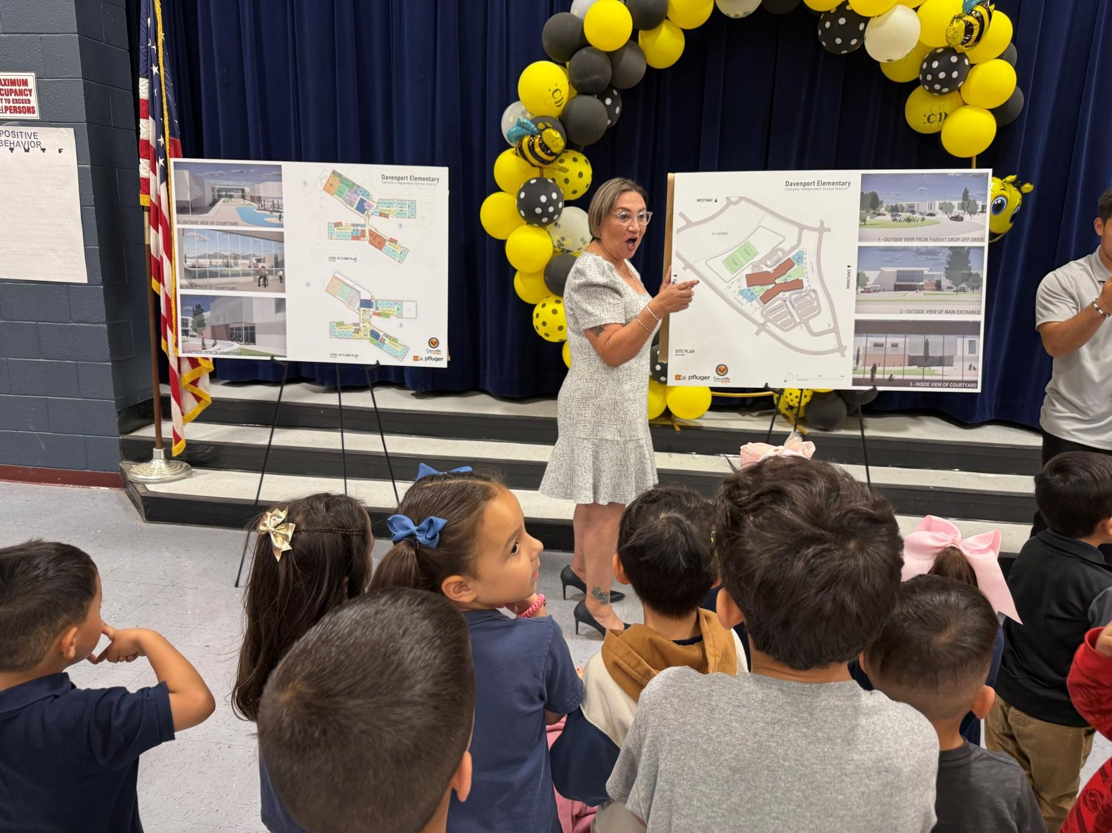
2024 Bond Program Status – Community Engagement
Davenport ES Bond Signage Unveiling
April 14, 2025
2024

Slide 12
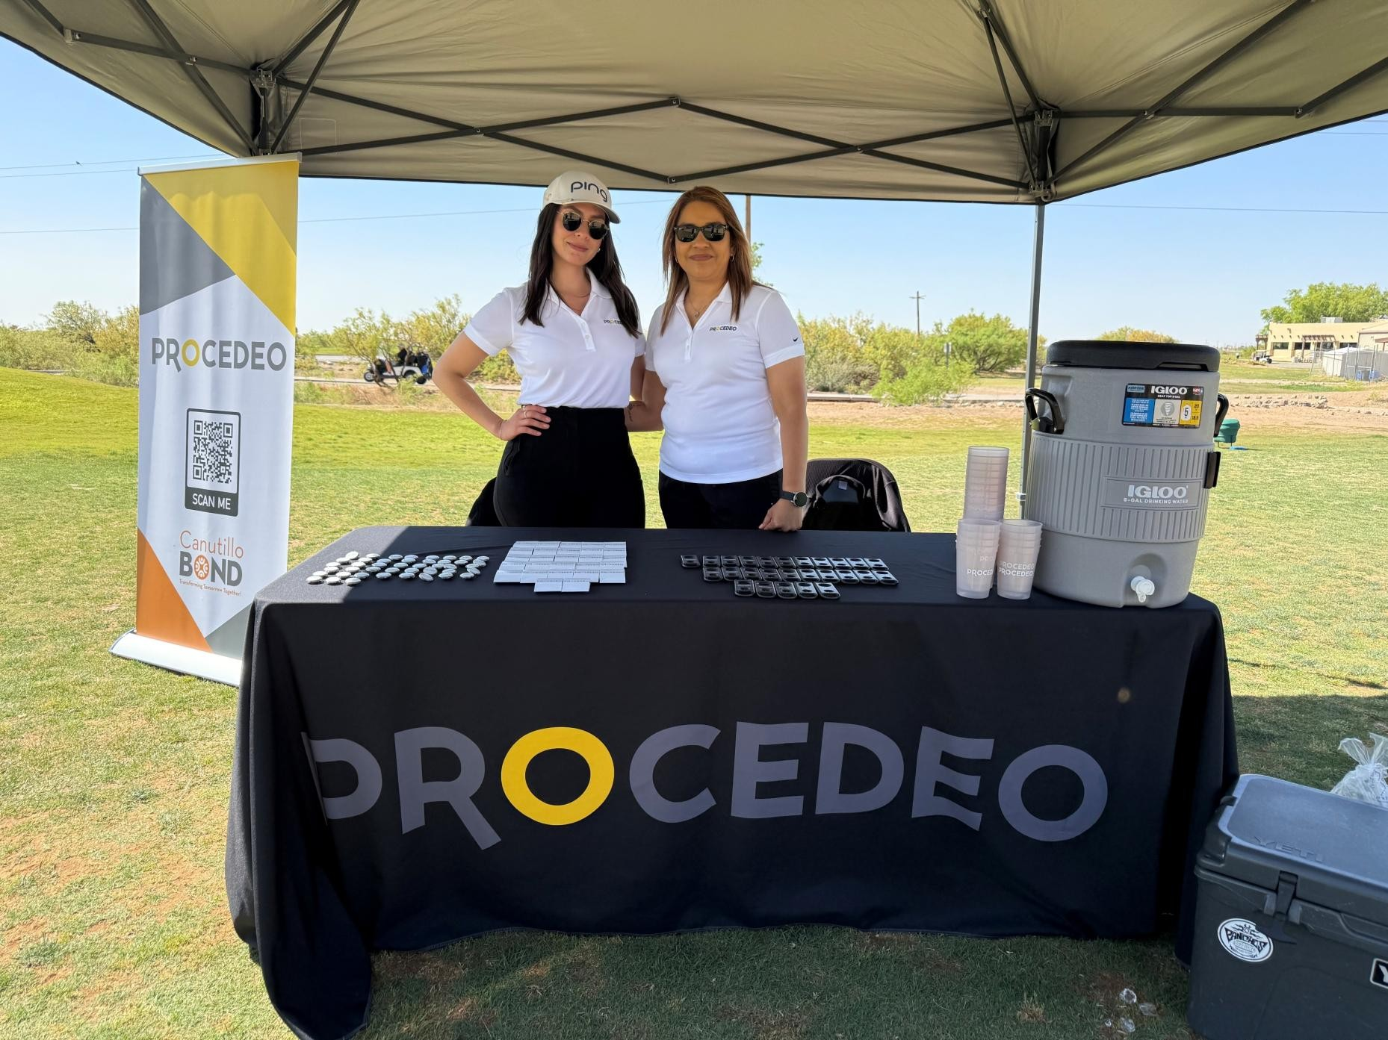
2024 Bond Program Status – Community Engagement
CAFÉ Golf Tournament
May 02, 2025
PROCEDEO Title
Sponsor

Slide 13
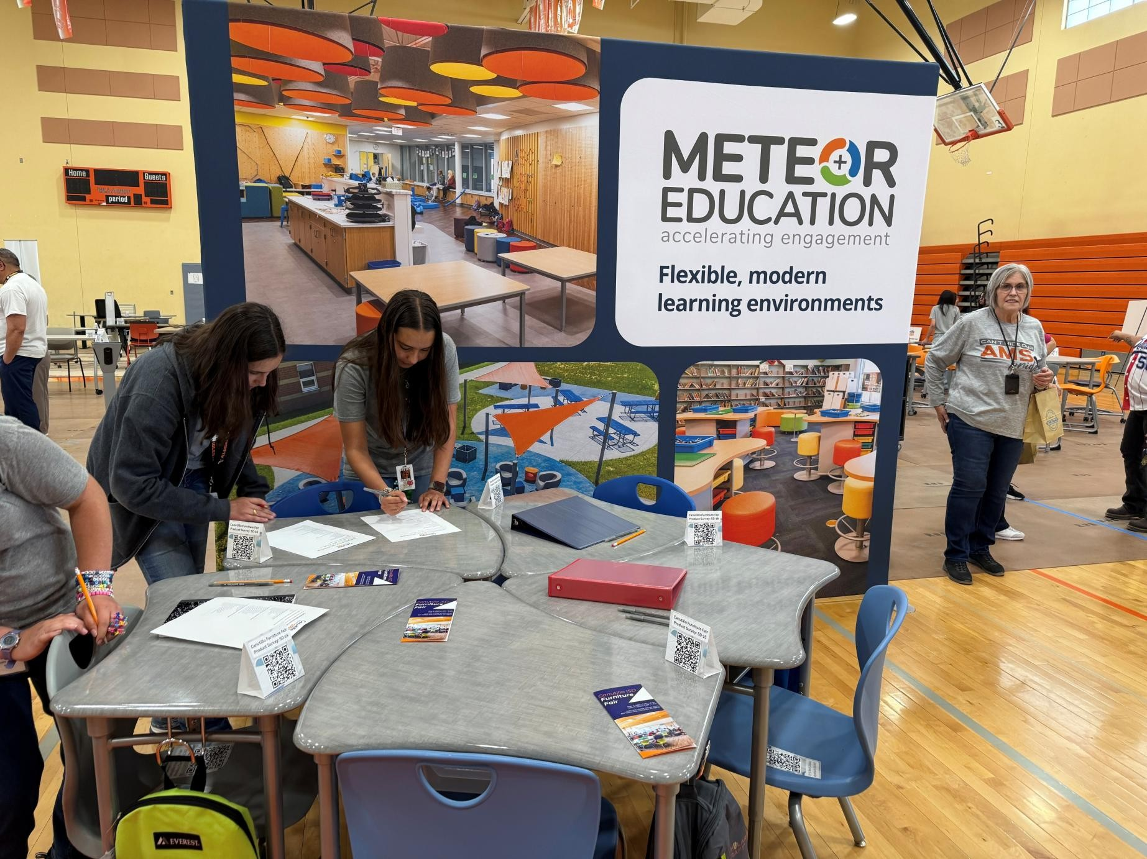
2024 Bond Program Status – Community Engagement
District-wide Furniture Fair Expo
May 06-07, 2025
2024

Slide 14










4yr
2024-2028
2024 Bond Program Status – Overall Budget
10
PROJECTS
$379M
PROPOSITION A
CATEGORY | Budget Managed by PROCEDEO | Total
New Facilities/Renovations for 10 Projects | $ 378,955,000 | $ 378,955,000
Interest Earned to Date | $ 477,502 | $ 477,502
Canutillo ISD 2024 Bond Program Total | $ 379,432,502 | $ 379,432,502
Encumbered to Date |  | $ 27,652,484
Amount Paid to Date |  | $ 23,173,069
Forecasted Additional Commitments |  | $ 328,129,447
Interest Earned to Date |  | $ 477,502
Total |  | $ 379,432,502
84.5% Forecasted Additional Commitments
15.5% Cost Committed to Date

Slide 15
2024 Bond Program Status – Program Schedule
June 5, 2025
Project | 2024 |  | 2025 |  | 2026 | 2027
Canutillo HS
Canutillo ES
Childress ES
Damian ES
Garcia ES
Reyes ES
NW Early College HS
Canutillo MS*
Alderete MS*
Davenport ES*
10/22/24 |  | TODAY |  | *Schedule subject to change; verify with Program Director
Design NTP

Slide 16



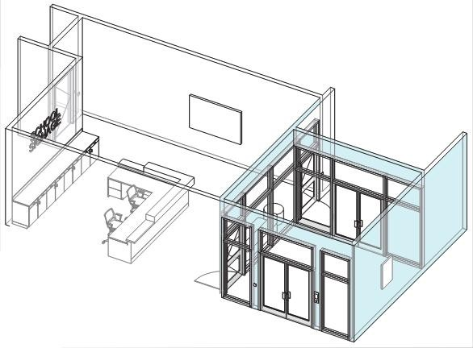



999-001 District Security Upgrades
Project Type | Renovation
Contractor | UDT / CMAR
Total Project Size | District Wide
Tentative Completion Date | August 2026
Security Upgrades*
General Scope
Safety & Security Upgrades Include:
1-to-1 Camera Replacements
New Cameras at Campus Blind Spots
Webex District Security System for District Emergency Response Accessible via New Phones, App, & Wi-fi Calling
Secure Entry Vestibule Upgrade
District Security Assessment
General Scope
Technology Upgrades Include:
Interactive Flat Panels at all Classrooms and throughout Campuses – Fixed and/or Movable
Total Budget | $ 1,412,680
*Security upgrades for Webex and Access Control district-wide
Overall Paid to Date
52%
CISD Design Guidelines - Typical Secure Vestibule Upgrade
Project Updates
 | Update | Wi-Fi | Cameras | Webex – Phase 1 | Webex – Phase 2 | Vestibule
1 | Reyes ES | Complete | In Progress | Complete | Complete | Existing
2 | Damian ES | Complete | Complete | Complete | Complete | New Construction
3 | Garcia ES |  | Complete | Complete |  | New Construction
4 | Childress ES |  |  | Complete |  | New Construction
5 | Canutillo ES |  |  | Complete |  | New Construction
6 | Canutillo HS |  |  | Complete |  | Upgrade Existing

Slide 17






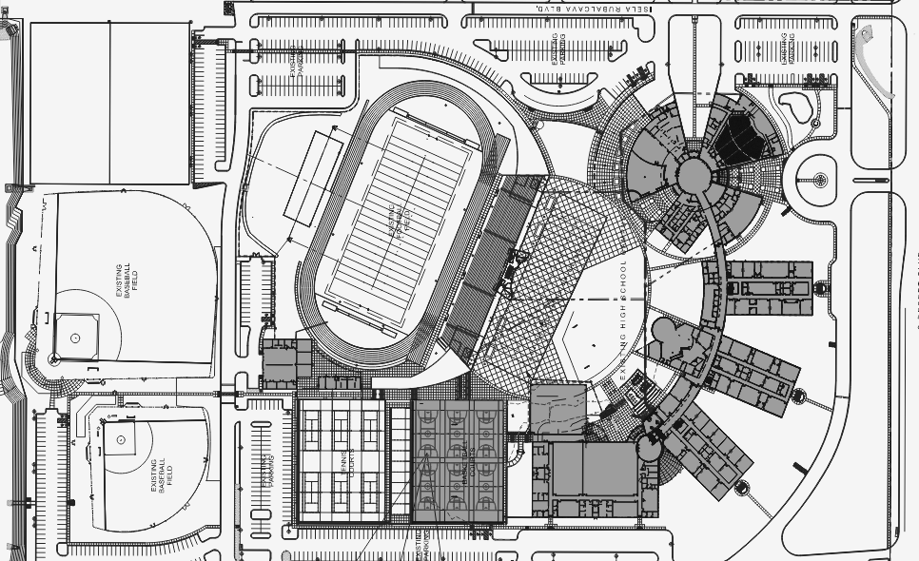

001-001 Canutillo HS
6675 S Desert Blvd, El Paso, TX 79932
Design
75%
_{Construction} Overall Paid to Date
4% 6%
Project Type | Renovation
Architect | GA Architecture
Contractor (CMAR) | AO General Contractors
Total Project Size | 80,000 SF
Tentative Construction Start | August 2025
Tentative Substantial Completion | Summer 2026
Design NTP
October 22, 2024
Pre-Con NTP
October 23, 2024
Construction NTP
Pending
GMP
Project Floor Plan
Project Budget
General Scope
Safety & Security – Vestibule, PA/Fire Alarm/Security Cameras/Access Control System Upgrades
Roofing Repairs, Metal Roof & Canopies
New Cooling Towers, Boilers, Heat Pumps, Replace Evaporative Cooling System
CTE Upgrades
New Wireless Access Points
New Softball/Baseball Playfields Lighting
Total Budget | $ 16,375,565
CMAR GMP | $--
Owner Contingency | $--
Project Checklist
NA | Re-Zoning/Re-Platting
✓ | Civil Survey
✓ | Geotechnical Report
✓ | Roofing Assessment
✓ | Sewer Scope & Report
NA | Utility Agreements – EPW/EPE/TGS/Comms
✓ | Site Visit/Assessments with AE/CMAR
✓ | 50% CDs Page Turn Meeting
✓ | Pricing/Value Engineering Negotiations
NA | Purchase Sales Agreement
NA | Traffic Impact Analysis
Possible Alternates Contingent on Project Savings:
Exterior Sidewalk, Reseal All Pavement
Replace/Repair Window Wall Gaskets, Reseal Exterior Masonry
Ceiling Replacement
Instructional Technology
New Basketball & Tennis Courts
Project Updates
 | Update | Context/Resolution
1 | Baseball/Softball Playfields Reached Substantial Completion 01/13! | Playfields Ribbon Cutting Ceremony took place 02/07
2
3

Slide 18





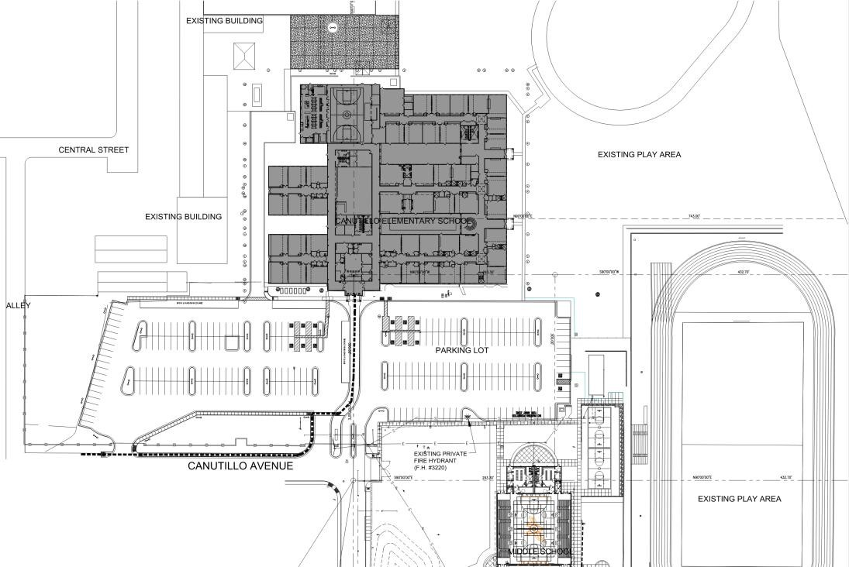

101-001 Canutillo ES
651 Canutillo Ave, Canutillo, TX 79835
Design
Construction
0%
Overall Paid to Date
95%
3%
Project Type | Renovation
Architect | GA Architecture
Contractor (CMAR) | Banes General Contractors
Total Project Size | 80,000 SF
Tentative Construction Start | July 2025
Tentative Substantial Completion | Early 2026
Design NTP
October 22, 2024
Pre-Con NTP
October 23, 2024
Construction NTP
Pending
GMP
Project Floor Plan
Project Budget
General Scope
Safety & Security Upgrades – Vestibule, Fire Alarm/PA/Emergency Notification Systems, Security Cameras & Access Control
Network Infrastructure & Wireless Access Points
Replace HVAC Units
New Roofing & Repairs to Parapets
Total Budget | $ 9,570,316
CMAR GMP | $--
Owner Contingency | $--
Project Checklist
NA | Re-Zoning/Re-Platting
✓ | Civil Survey
✓ | Geotechnical Report
✓ | Roofing Assessment
✓ | Sewer Scope & Report
NA | Utility Agreements – EPW/EPE/TGS/Comms
✓ | Site Visit/Assessments with AE/CMAR
✓ | 90% CDs Page Turn Meeting
✓ | Pricing/Value Engineering Negotiations
NA | Purchase Sales Agreement
NA | Traffic Impact Analysis
Possible Alternates Contingent on Project Savings:
New Bus Access Route
New Sprinkler System, Water Heater Replacement, Reseal All Pavement, Replace Window Blinds, Replace Mechanical Units
Project Updates
 | Update | Context/Resolution
1 | Ongoing Coordination for Upcoming Wi-fi, Security Camera, and Access Control Upgrades
2 | Webex Phase 1 complete
3

Slide 19





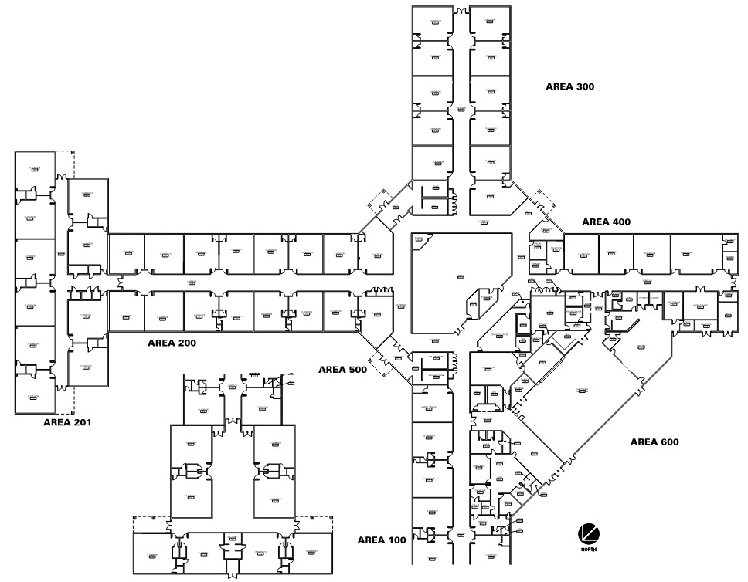
104-001 Childress ES
7700 Cap Carter Rd. Vinton, Texas 79821
Design
Construction Overall Paid to Date
0% 3%
100%
Project Type | Renovation
Architect | Mijares-Mora Architects
Contractor (CMAR) | Jordan Foster Construction
Total Project Size | 80,000 SF
Tentative Construction Start | July 2025
Tentative Substantial Completion | Spring 2026
Design NTP
October 22, 2024
Pre-Con NTP
October 23, 2024
Construction NTP
Pending
GMP
Project Floor Plan
Project Budget
General Scope
Safety & Security Upgrades – Vestibule, Fire Alarm/PA/Emergency Notification Systems, Security Cameras & Access Control
Roof Maintenance – Sealants & Walk Pad
New HVAC Units
Infrastructure Upgrades – Network Switches & Cabling, Wi-Fi
Total Budget | $ 7,269,598
CMAR GMP | $--
Owner Contingency | $--
Project Checklist
NA | Re-Zoning/Re-Platting
✓ | Civil Survey
✓ | Geotechnical Report
✓ | Roofing Assessment
✓ | Sewer Scope & Report
NA | Utility Agreements – EPW/EPE/TGS/Comms
✓ | Site Visit/Assessments with AE/CMAR
✓ | 90% CDs Page Turn Meeting
✓ | Pricing/Value Engineering Negotiations
NA | Purchase Sales Agreement
NA | Traffic Impact Analysis
Possible Alternates Contingent on Project Savings:
Replace Black-Top
Replace Carpet Flooring with LVT
Replace Millwork & Sinks at Classrooms
Shade Structures at Soccer Field
Renovate Science, Computer Labs and Library – flooring, paint millwork, lights
Project Updates

Slide 20




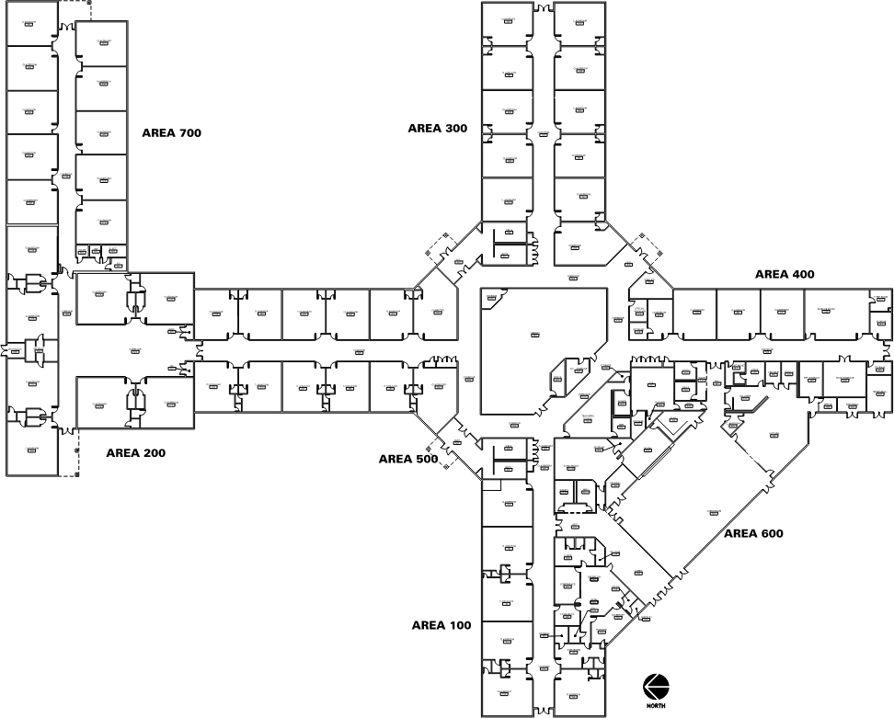

103-001 Damian ES
6300 Strahan Rd, El Paso, TX 79932
Design
Construction
0%
Overall Paid to Date
7%
100%
Project Type | Renovation
Architect | Mijares-Mora Architects
Contractor (CMAR) | Jordan Foster Construction
Total Project Size | 80,000 SF
Tentative Construction Start | July 2025
Tentative Substantial Completion | Spring 2026
Design NTP
October 22, 2024
Pre-Con NTP
October 23, 2024
Construction NTP
Pending
GMP
Project Floor Plan
Project Budget
General Scope
Safety & Security Upgrades – Vestibule, Fire Alarm/PA/Emergency Notification Systems, Security Cameras & Access Control
Roof Maintenance – Sealants & Walk Pad
New HVAC Units
Infrastructure Upgrades – Network Switches & Cabling, Wi-Fi
Total Budget | $ 7,299,537
CMAR GMP | $--
Owner Contingency | $--
Project Checklist
NA | Re-Zoning/Re-Platting
✓ | Civil Survey
✓ | Geotechnical Report
✓ | Roofing Assessment
✓ | Sewer Scope & Report
NA | Utility Agreements – EPW/EPE/TGS/Comms
✓ | Site Visit/Assessments with AE/CMAR
✓ | 90% CDs Page Turn Meeting
✓ | Pricing/Value Engineering Negotiations
NA | Purchase Sales Agreement
NA | Traffic Impact Analysis
Possible Alternates Contingent on Project Savings:
Additional Student Restrooms
Interior Paint, Seal Masonry Joints
Exterior Stucco & Paint
Replace All Water Heaters
Multipurpose Space
Project Updates
 | Update | Context/Resolution
1 | Webex Phase 1 /Phase 2 complete
2 | Infrastructure Upgrades – Network and Security Cameras Installation Complete
3

Slide 21



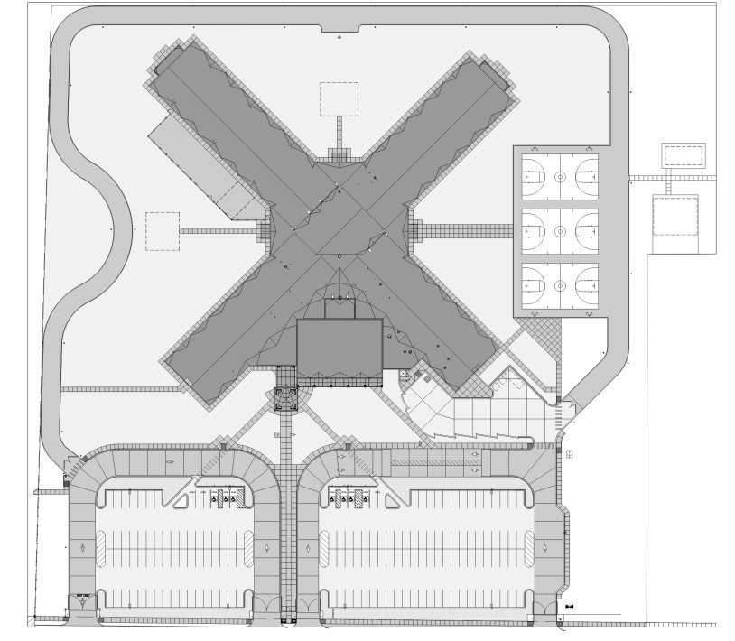
105-001 Garcia ES
6550 Westside Dr, El Paso, TX 79932
Design
Construction Overall Paid to Date
0% 3%
100%
Project Type | Renovation
Architect | Mijares-Mora Architects
Contractor (CMAR) | Jordan Foster Construction
Total Project Size | 80,000 SF
Tentative Construction Start | July 2025
Tentative Substantial Completion | Spring 2026
Design NTP
October 22, 2024
Pre-Con NTP
October 23, 2024
Construction NTP
Pending
GMP
Project Floor Plan
Project Budget
General Scope
Safety & Security Upgrades – Vestibule, Fire Alarm/PA/Emergency Notification Systems, Security Cameras & Access Control
Roof Maintenance – Sealants & Walk Pad
New HVAC Units
Infrastructure Upgrades – Network Switches & Cabling, Wi-Fi
Total Budget | $ 7,007,109
CMAR GMP | $--
Owner Contingency | $--
Project Checklist
NA | Re-Zoning/Re-Platting
✓ | Civil Survey
✓ | Geotechnical Report
✓ | Roofing Assessment
✓ | Sewer Scope & Report
NA | Utility Agreements – EPW/EPE/TGS/Comms
✓ | Site Visit/Assessments with AE/CMAR
✓ | 90% CDs Page Turn Meeting
✓ | Pricing/Value Engineering Negotiations
NA | Purchase Sales Agreement
NA | Traffic Impact Analysis
Possible Alternates Contingent on Project Savings:
Clean Existing Ductwork
Replace All Water Heaters
Additional Staff Restrooms
New Interior Paint
New Speaker System & Stage at Gym
Replace Playground Canopies
Project Updates
 | Update | Context/Resolution
1 | Ongoing coordination for upcoming Wi-Fi, and access control upgrades
2 | Webex Phase 1 complete
3 | Security Cameras Installation Complete

Slide 22





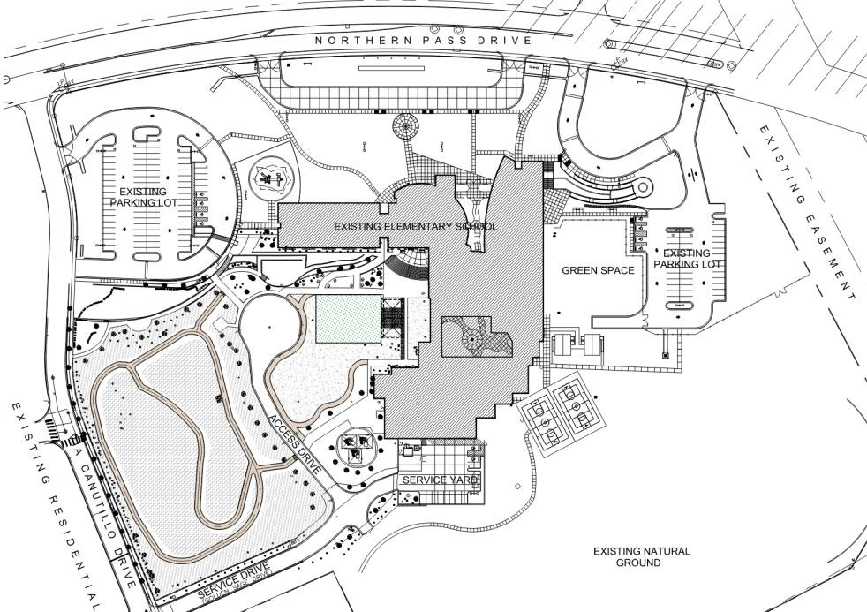
106-001 Reyes ES
7440 Northern Pass Dr, El Paso, TX 79911
Design
Construction
0%
Overall Paid to Date
100%
24%
Project Type | Renovation
Architect | GA Architecture
Contractor (CMAR) | Banes General Contractors
Total Project Size | 80,000 SF
Tentative Construction Start | July 2025
Tentative Substantial Completion | Early 2026
Design NTP
October 22, 2024
Pre-Con NTP
October 23, 2024
Construction NTP
Pending
GMP
Project Floor Plan
Project Budget
General Scope
Safety & Security Upgrades
MEP Backup Chiller & Cooling Tower
Upgrade Network Switches & Cabling, Security Cameras
New Instructional Technology
Wireless Upgrades
Total Budget | $ 1,998,731
CMAR GMP | $--
Owner Contingency | $--
Project Checklist
NA | Re-Zoning/Re-Platting
✓ | Civil Survey
✓ | Geotechnical Report
✓ | Roofing Assessment
✓ | Sewer Scope & Report
NA | Utility Agreements – EPW/EPE/TGS/Comms
✓ | Site Visit/Assessments with AE/CMAR
✓ | 90% CDs Page Turn Meeting
✓ | Pricing/Value Engineering Negotiations
NA | Purchase Sales Agreement
NA | Traffic Impact Analysis
Possible Alternates Contingent on Project Savings:
Reseal/Recoat Asphalt Pavements
Artificial Turf Areas & Walking Surface
Metal Shade Structure
Project Updates
 | Update | Context/Resolution
1 | Wireless infrastructure upgrades completed November 2024
2 | Webex Phase 1 complete
3

Slide 23




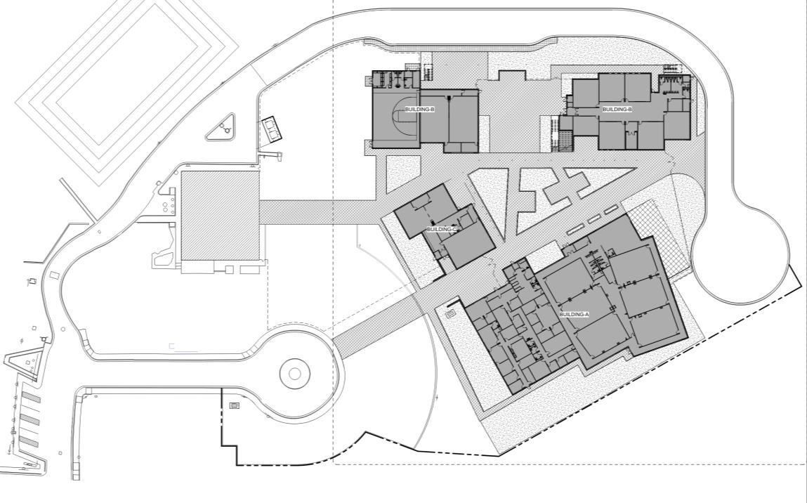
003-001 NW Early College HS
6701 S Desert Blvd, El Paso, TX 79932
Design
50%
Construction
0%
Overall Paid to Date
2%
Project Type | Renovation
Architect | MNK Architects
Contractor (CMAR) | Jordan Foster Construction
Total Project Size | 45,000 SF
Tentative Construction Start | September 2025
Tentative Substantial Completion | Spring 2027
Design NTP
October 22, 2024
Pre-Con NTP
October 23, 2024
Construction NTP
Pending
GMP
Project Floor Plan
Project Budget
General Scope
The proposed design includes the construction of 31,140 SF of Academic / Classrooms building, 4,732 SF of Fine Arts
/ Multipurpose building, 8,583 SF of Administration building, 3,704 SF of Athletics building, and 14,748 SF Science Building
Total Budget | $ 40,458,824
CMAR GMP | $--
Owner Contingency | $--
Project Checklist
NA | Re-Zoning/Re-Platting
✓ | Civil Survey
✓ | Geotechnical Report
NA | Roofing Assessment
NA | Sewer Scope & Report
 | Utility Agreements – EPW/EPE/TGS/Comms
✓ | Site Visit/Assessments with AE/CMAR
 | 90% CDs Page Turn Meeting
✓ | Pricing/Value Engineering Negotiations
 | Ground Lease Agreement
NA | Traffic Impact Analysis
Project Updates
 | Update | Context/Resolution
1 | Land Acquisition Update – Pending Ground Lease Agreement | Pending EPCC Board Approval
2 | Ongoing design revisions to reach established project budget
3

Slide 24




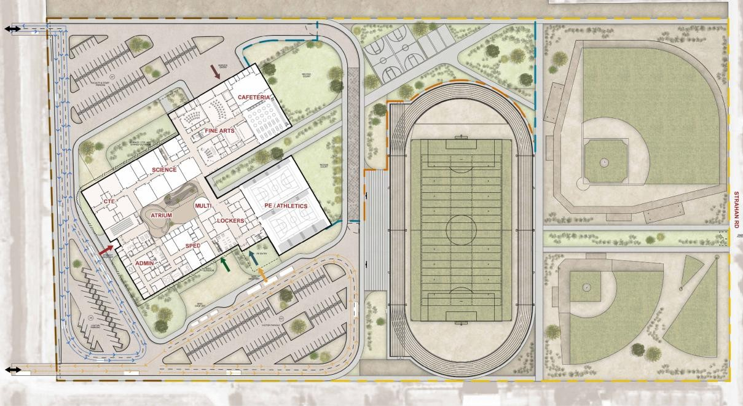
041-001 Canutillo MS
6201 Strahan Rd, El Paso, TX 79932
Design
50%
Construction Overall Paid to Date
0% 8%
Project Type | New Construction
Architect | DLR Group
Contractor (CMAR) | Banes General Contractors
Total Project Size | 165,000 SF
Tentative Construction Start | November 2025
Tentative Substantial Completion | Late 2027/Early 2028
Design NTP
October 22, 2024
Pre-Con NTP
October 23, 2024
Construction NTP
Pending
GMP
Project Floor Plan
Project Budget
General Scope
New state-of-the-art 21st Century Learning Facility: Cafeteria, Library, Gymnasium, Admin, Collaboration Spaces, Special Education, New Playfields, New Parking, Bus Loop
Total Budget | $ 106,847,954
CMAR GMP | $--
Owner Contingency | $--
Project Checklist
✓ | Re-Zoning/Re-Platting
✓ | Civil Survey
✓ | Geotechnical Report
✓ | Roofing Assessment
NA | Sewer Scope & Report
 | Utility Agreements – EPW/EPE/TGS/Comms
✓ | Site Visit/Assessments with AE/CMAR
 | 90% CDs Page Turn Meeting
✓ | Pricing/Value Engineering Negotiations
✓ | Purchase Sales Agreement
✓ | Traffic Impact Analysis
Project Updates
 | Update | Context/Resolution
1 | Land Acquisition Update – Closed
2 | Ongoing coordination for existing site abatement and demolition scope
3 | Design Development Phase – Complete June BOT

Slide 25







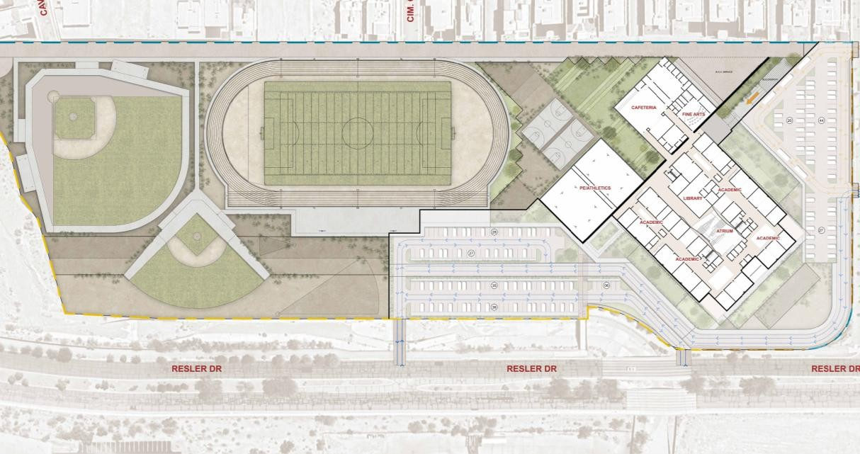
042-001 Alderete MS
1634 Resler Dr. El Paso, Texas, 79911
Design
50%
Construction Overall Paid to Date
0% 9%
Project Type | New Construction
Architect | DLR Group
Contractor (CMAR) | Banes General Contractors
Total Project Size | 165,000 SF
Tentative Construction Start | November 2025
Tentative Substantial Completion | Late 2027/Early 2028
Design NTP
October 22, 2024
Pre-Con NTP
October 23, 2024
Construction NTP
Pending
GMP
Project Floor Plan
Project Budget
General Scope
New state-of-the-art 21st Century Learning Facility: Cafeteria, Library, Gymnasium, Admin, Collaboration Spaces, Special Education, New Playfields, New Parking, Bus Loop
Total Budget | $ 106,813,514
CMAR GMP | $--
Owner Contingency | $--
Project Checklist
✓ | Re-Zoning/Re-Platting
✓ | Civil Survey
✓ | Geotechnical Report
✓ | Roofing Assessment
NA | Sewer Scope & Report
 | Utility Agreements – EPW/EPE/TGS/Comms
✓ | Site Visit/Assessments with AE/CMAR
 | 90% CDs Page Turn Meeting
✓ | Pricing/Value Engineering Negotiations
✓ | Purchase Sales Agreement
✓ | Traffic Impact Analysis
Project Updates
 | Update | Context/Resolution
1 | Land Acquisition Update – Closed
2 | Design Development Phase – Complete June BOT
3

Slide 26



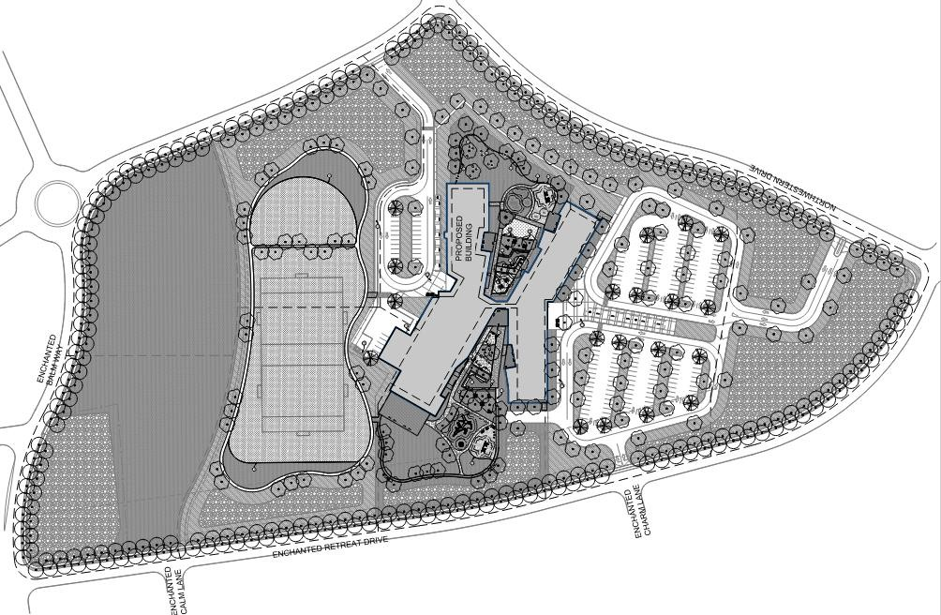
102-001 Davenport ES
Enchanted Hills, Unit Seven
Design
50%
Construction Overall Paid to Date
0% 1%
Project Type | New Construction
Architect | Pfluger Architects
Contractor (CMAR) | LDCM Solutions
Total Project Size | 119,000 SF
Tentative Construction Start | September 2025
Tentative Substantial Completion | Spring 2027
Design NTP
October 22, 2024
Pre-Con NTP
October 23, 2024
Construction NTP
Pending
GMP
Project Floor Plan
Project Budget
General Scope
New state-of-the-art 21st Century Learning Facility to include 36 TEA (Texas Education Agency) Flexibility Level 3-4 classrooms, collaborative learning spaces, and grade-level neighborhoods, all with a strong emphasis on outdoor connections.
Total Budget | $ 73,901,172
CMAR GMP | $--
Owner Contingency | $--
Project Checklist
✓ | Re-Zoning/Re-Platting
✓ | Civil Survey
✓ | Geotechnical Report
✓ | Roofing Assessment
✓ | Sewer Scope & Report
 | Utility Agreements – EPW/EPE/TGS/Comms
✓ | Site Visit/Assessments with AE/CMAR
 | 90% CDs Page Turn Meeting
✓ | Pricing/Value Engineering Negotiations
 | Purchase Sales Agreement
✓ | Traffic Impact Assessment
Project Updates
 | Update | Context/Resolution
1 | Land Acquisition Update – to close by June
2 | Design Development Phase – Complete June BOT
3

Slide 27

2024 Bond Program Status – Quarterly Meeting Schedule
Next Quarterly Meeting Date

Slide 28
